Slide 1
Semantic Procedure Analysis:
Modularizing Operating Procedures for More Efficient Use and Comprehensive Updating
Thomas R. Kindervater, PE
Center for Operator Performance
David A. Strobhar, PE
Beville Engineering / Center for Operator Performance
Notes:
Good Morning. As Alan said, I’m Tom Kindervater. My presentation this morning is on Semantic Procedure Analysis – a method for Modularizing Operating Procedures for more efficient use and comprehensive updating. This paper documents the results of research underwritten by the Center for Operator Performance.

Slide 2










www.operatorperformance.org
Notes:
The Center for Operator Performance, or COP, is an Industry-Academia Collaboration whose current membership of operating companies and control system vendors, is shown on this slide. The COP exists through the efforts of the founding members, Beville Engineering and Wright State University in Dayton, Ohio. The focus of the COP is improving process plant operator tools and training to make those individuals more effective in minimizing and/or preventing Health, Safety, and Environmental issues. The research work being done to investigate new concepts and methodologies is generally conducted by university graduate studies through grants funded by the COP, with oversight, direction, and process plant access provided by COP members. Membership is open to all businesses, organizations, and government agencies that express a desire and show ability to actively participate, collaboratively and openly, in support of the COP objectives.

Slide 3
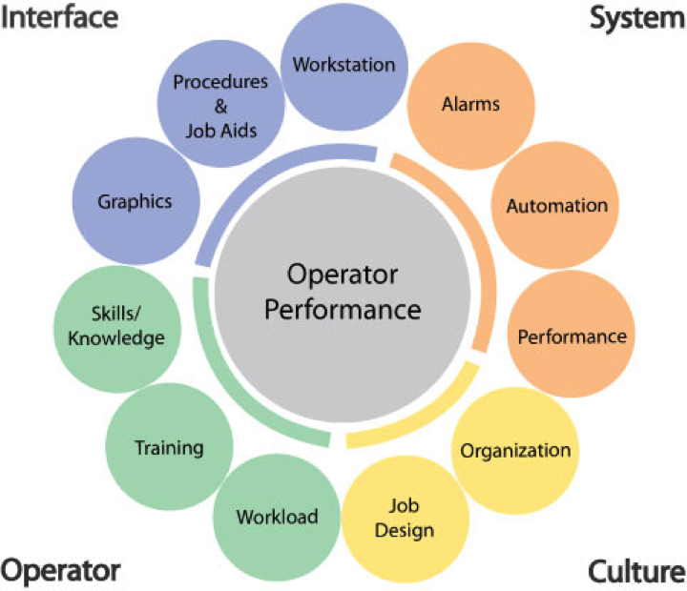
Performance Shaping Factors
Notes:
The Center for Operator Performance has identified 11 key factors which shape human performance and can impact operations. These human performance shaping factors are the focus for research as the COP pursues its objective to produce high performance operators. As illustrated on this slide, the factors are grouped by four areas: Interface – which contains graphics, procedures, and workstation; System – which contains alarms, automation, and performance; Operator – which contains knowledge, training, and workload; and Culture – which contains job design and organization. Although each key factor is distinct, the research topics are not independent of or isolated from each other.
The COP commissioned Penn State University to examine new ways to improve knowledge management in process plant operating procedures. This research developed an automated Semantic Procedure Analyzer (SPA) and an associated methodology to chunk operating procedures into logical modules. The completed research and resulting procedure analysis tool evolved to include three of these human performance shaping factors: knowledge, training, and procedures.

Slide 4
Operational Knowledge _>
Procedures
Knowledge Management
Knowledge Capture
Knowledge Presentation
Make knowledge more accessible
Improve operator performance
Retain tacit knowledge
Combine with explicit knowledge
Notes:
Most companies continue to face the loss of knowledge through the retirement of experienced workers. The knowledge lost with retirement is mostly tacit in nature. Tacit knowledge is developed over years of experience and repetition. It is understood by experienced operators without being written down and, as such, is often not captured as part of the explicit knowledge in written procedures.
Knowledge management entails two key facets: knowledge presentation and knowledge capture. The initial research focus was on knowledge presentation in operating procedures. This form of knowledge presentation is an opportunity to quickly improve operator performance through improved clarity of the content, easier updating, and real-time access.
TACIT KNOWLEDGE - expressed or understood without being directly stated
EXPLICIT KNOWLEDGE - very clear and complete

Slide 5
Operating Procedures
Normal Procedures
Emergency Procedures
All contain steps and tasks for console and field operators
Collectively, establish unit operator responsibilities for planned operational changes and abnormal situations
Notes:
Operating procedures are generally categorized as “Normal procedures” or “Emergency procedures”. Normal procedures document the tasks and steps required for each operator (field and console) to complete a repeated but infrequently performed operational change, such as unit startup or shutdown. Emergency procedures document the tasks and steps required for each operator in response to a given abnormal situation. Collectively, these operating procedures create a set of documents covering planned operational changes and multiple abnormal situations or upsets.

Slide 6
Current Challenges
Increasing industry emphasis
  Expanding number
  Growing depth of details
Used for operation and training
Updating is labor intensive
Multiple authors
  Different terminology
  Prone to inconsistencies for tasks common to multiple procedures
Absence of tacit knowledge
Notes:
However, several challenges exist when it comes to using and maintaining operating procedures.
There is an increased reliance on procedures and the need to ensure their accuracy, thus increasing their size and making the task of updating them increasingly manpower intensive.
Procedures are often used to train new operators and windup containing details needed for training, but not for operation.
Many emergency procedures ultimately end up on the same path, that being the shutdown of the process unit. Therefore, many of the tasks and their steps are duplicated in each procedure. While the amount of unique information in any given procedure can be relatively low, the task of updating common information among many procedures is arduous and prone to inconsistencies.
Most procedures have evolved over time with different authors and reviewers involved in their creation and updating. The result has been common tasks and steps are described in different ways, sometimes with different terminology from procedure to procedure. For inexperienced operators, this can hinder repetitive learning or, worse, lead to confusion.
Most procedures do not contain tacit knowledge
For large units with multiple field operators, a single procedure can have a large amount of information that is irrelevant to one or more specific positions. The operators in those positions must filter out all the noise in the procedure to find the information that is relevant, with an increased probability of missing something important.
Console operators in particular can be responsible for multiple units and a plant utility upset may require them to access multiple procedures.

Slide 7
Solution
Identify procedural modules (“chunking”)
  Related tasks
  Supporting information
Establish common terminology
Index modules used by procedures
Store modules and indexes in database
Use database to:
  Maintain and update modules
  Publish updated procedures
Notes:
A solution to the problem would be to take all the existing procedures for an operating area and capture key procedural modules, which would contain related tasks and supporting information, in a central database that could be used to populate different procedures. This would support the use of common terminology and simplify updating of procedures. Utilizing a relational database would streamline the effort to update modules and to publish the updated procedures.
However, there are challenges in implementing this solution. The volume of procedure information that exists makes a brute force approach an impractical task. The procedures vary in format, content, and style, which can hinder identification of common “chunks.”

Slide 8
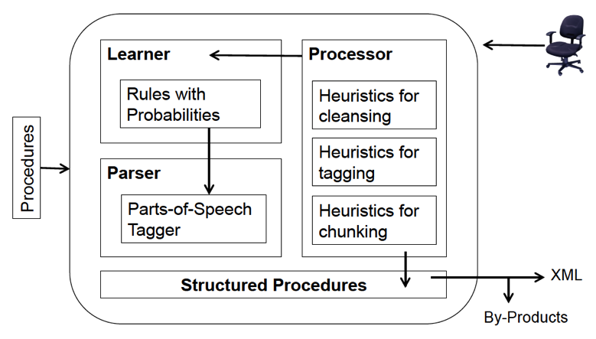
Semantic Procedure Analyzer
Notes:
Penn State researchers developed a solution, named the Semantic Procedure Analyzer, for the Center for Operator Performance. A set of automatable heuristics were developed that can speed up the identification and development of procedural modules. The cleansing heuristics identify boiler-plate or meta-information in the procedure content (titles, authors, revisions, etc.) and marks those statements differently than the statements containing task instructions and information; the tagging heuristics parse the statements into parts of speech; and the chunking heuristics separate the content into modules of related tasks and supporting information. This approach significantly reduces the level of effort required. In addition, the heuristics can be trained to handle inconsistencies in procedure style, format, and content.

Slide 9
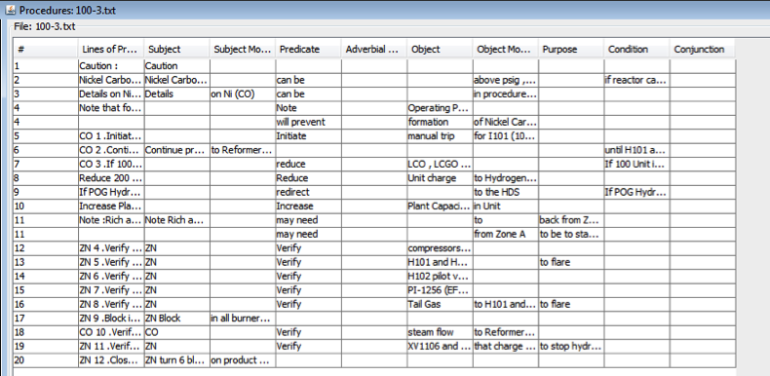
Cleansed & Tagged Output
Notes:
The result is that a procedure can be converted into a table based on the key attributes shown in the table on this slide: subject, verb, object, subject and object modifiers, purpose, and condition. Manual review and adjustment of the cleansing and tagging heuristics output by an experienced operator is encouraged to expedite and enhance the tool’s “learning” process.

Slide 10
Expert Operator Review
Establish common terminology
  Replace variations with preferred naming for:
    Equipment names
    Equipment ID
    Operator designations
    Actions
    States
Add operator experience (tacit knowledge)
  Insert information associated with a task / step
  Augment conditional statements
Notes:
As part of this first manual review, the information (taxonomies) for equipment, operators, actions, and interruptions are available for review. These lists of preferred terminology can be retained by operating area and used to standardize the terminology contained in the procedures for that operating area. Using consistent terminology has two benefits. It enhances learning of tasks common to multiple procedures and it makes identification of common procedural modules more accurate.
As the research effort progressed, it was recognized that at this point in the analysis, tacit knowledge capture could be included. The procedure content showed where tacit knowledge was required with phrases such as “when needed”, “long enough”, and “when able”. Expert operators can be interviewed and/or review the heuristic output to determine what tacit knowledge is useful during execution of the procedure. This expert operator tacit knowledge can be added to the procedure at this point in the analysis methodology before it is “chunked” into modules.
After the procedure information has been “cleansed,” “tagged,” and reviewed, it is ready to be “chunked” into modules of related tasks.

Slide 11
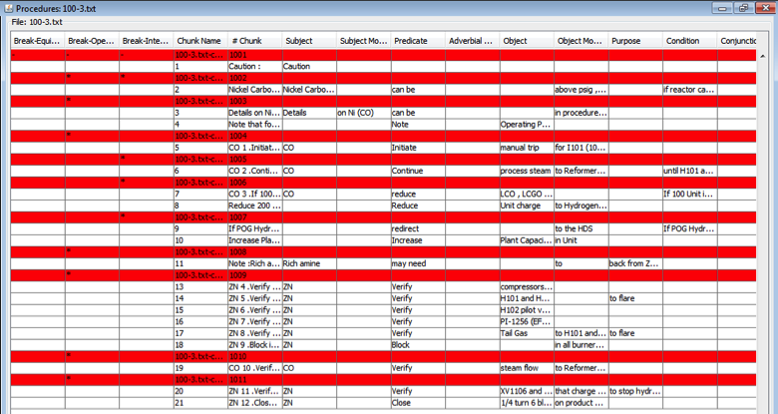
Module “Chunking” Output
Notes:
The chunking heuristics can group procedure content by any combination of 3 options.
By Operator – where procedure steps are clustered based on who implements the action;
By Interruption – where procedure steps are clustered based on interruption;
By Equipment – where procedure steps are clustered based on lists of associated equipment.
The example shown on this slide was chunked by Operator and Interruption. Each red line in the table on this slide identifies the beginning of a “chunk” or module proposed by the Semantic Procedure Analyzer. As with the earlier heuristic output, manual review and adjustment of the chunking heuristics output by an experienced operator is encouraged.

Slide 12
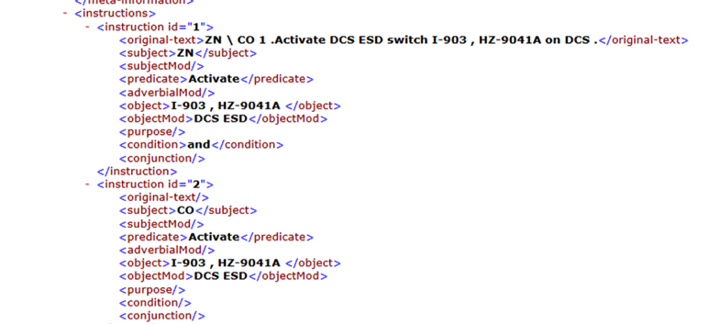
Final SPA Output
Notes:
The Semantic Procedure Analyzer generates an XML file of the “chunked” modules that can be easily imported into a relational database. From there structured procedures can be published, updating of the modules can be performed, and further revisions can be made to the modules and their associated steps to improve the accuracy of the material.
The final reporting function is to generate a commonality report, showing similar modules that are used in different procedures within the specified operating area. Identifying common modules of procedural steps and re-using them among multiple procedures creates consistency in the terminology used among all procedures. It also facilitates the use of a relational database to maintain and publish the updated procedures since only the affected modules need to be revised, greatly reducing the effort to keep procedures up-to-date.

Slide 13
Results – Application of Semantic Procedure Analysis
One plant
  15 Emergency procedures
  40 pages of text
Initial Module chunking, minimal review
  62 modules
  291 instructions
Notes:
The Semantic Procedure Analyzer and the methodology described in this paper has been implemented at one plant. That application revealed that only 10% of the content contained in 15 emergency procedures was unique.
In order to help evaluate the various parts of the analysis method, an initial module chunking exercise, with minimal review, was performed first. That exercise converted the 15 procedures into 62 modules and a total of 291 instructions.

Slide 14
Results – Application of Semantic Procedure Analysis
Module chunking with experienced operator review of chunks and terminology
  22 modules
  179 instructions
Only 10% of content was unique
Unique content fits on 4 pages
Material needing review to update all 15 procedures was reduced by 90%
Notes:
That initial work was repeated and the results were reviewed by a knowledgeable person for consistent use of terminology and to identify common “chunked” modules. Adding standard taxonomy lists for terminology and the review by an experienced person, the procedure content was further reduced to 22 modules totaling 179 instructions. The procedure content for all 15 emergency procedures, after being organized by modules with consistent terminology, can be printed on four (4) pages instead of the original forty (40) pages – a 90% reduction in the amount of procedure content needing to be maintained.
The 22 modules were loaded into a relational database that is being used to generate and maintain procedures. Maintenance of the procedures is only 10% of what it was; and consistency in procedure terminology and depth of content has been improved.

Slide 15
Benefits
Substantial reduction in content to review
Consistent terminology among procedures
  Reduces potential confusion
  Reinforces common tasks
  Improves knowledge transfer to less experienced operators
Database storage
  Efficient environment for updating modules
  Can customize procedures for training versus operations or by specific position
  Supports electronic transfer to point of use
Notes:
Several benefits have been identified from the research and initial plant implementation.
There can be a substantial reduction in man-power required to review and maintain procedure content with up-to-date information due to the reduced content volume.
When the affected module is updated, all procedures using that module can be re-created from the database, quickly and accurately.
Consistent terminology and seamless inclusion of tacit knowledge will reduce potential confusion and improve training of less experienced operators.
Training and presentation of procedure information can be enhanced using these tools. Procedure documents for training can be created for specific operator positions with additional training information not included in the operating procedures. Learning the procedures has been made easier, as the volume of unique material to be studied has been reduced, and the information is presented in a consistent format and terminology.
The use of a relational database is far more amenable to electronic transfer of procedure documents, potentially improving access to current updated procedures versus hard copy distribution.
In summary, applying Semantic Procedure Analysis as the method for maintaining and using Operating Procedures can:
Provide procedures with better clarity of content
Facilitate tacit knowledge capture
Provide better training documents; and
Deliver updated procedures quicker;
All with less manpower.

Slide 16
www.operatorperformance.org
Notes:
That completes my presentation.
Thank you for your attention.

Slide 17
Notes:
Are there any questions?

